Slide 1
UNIT 1
Jaya Gangwani
JIET CSE

Slide 2
Objectives
Services, Mechanism, Attacks, Network security model,
Classical Encryption techniques -
Symmetric cipher model
Substitution techniques
Transposition techniques
Cryptanalysis
Steganography

Slide 3
What is Security?
The quality or state of being secure—to be free from danger
Computer Security-generic name for the collection of tools designed to protect data and to thwart hackers
Network Security-measures to protect data during their transmission
Internet Security-measures to protect data during their transmission over a collection of interconnected networks

Slide 4
Security Models
An organization can take several approaches to implement its security model. Let us summarize these approaches.
No Security: In this simplest case, the approach could be a decision to implement no security at all.
Security through obscurity: In this model, a system is secure simply because nobody knows about its existence and contents. This approach cannot work for too long, as there are many ways an attacker can come to know about it.
Hot Security: In this scheme, the security for each host is enforced individually. This is a very safe approach, but the trouble is that it cannot scale well. The complexity and diversity of modern sites/organizations makes the task even harder.
Network Security: Host security is tough to achieve as organizations grow and become more diverse. In this technique, the focus is to control network access to various hosts and their services, rather than individual host security. This is a very efficient and scalable model.

Slide 5
Security Goals
Confidentiality
Authentication
Integrity
Non-repudiation
Access control
Availability

Slide 6
Security Goals (Cont.)
Confidentiality
The principle of confidentiality is that only the sender and the intended recipient should be able to access the contents of a message. Confidentiality gets compromised if an unauthorized person is able to access the message.
Example of this could be a confidential email message sent by user A to user B, which is accessed by user C without the permission or knowledge of A and B.
This type of attack is called interception.

Slide 7
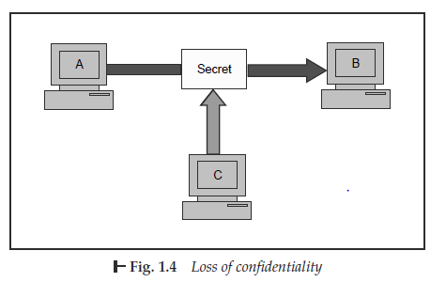

Slide 8
Security Goals (Cont.)
Authentication
Authentication mechanisms help establish proof of identities. The authentication process ensures that the origin of a electronic message or document is correctly identified.
For instance, suppose that user C sends an electronic document over the Internet to user B. However, the trouble is that user C had posed as user A when she sent this document to user B.
This type of attack is called as fabrication.

Slide 9
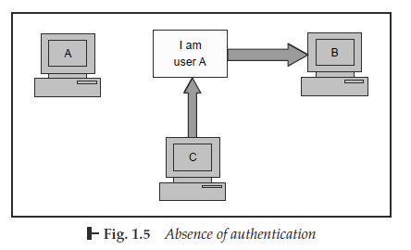

Slide 10
Security Goals (Cont.)
Integrity
When the contents of a message are changed after the sender sends it, but before it reaches the intended recipient, we say that the integrity of the message is lost.
For example, consider that user A sends message to user B. User C tampers with a message originally sent by user A, which is actually destined for user B. User C somehow manages to access it, change its contents and send the changed message to user B. User B has no way of knowing that the contents of the message changed after user A had sent it. User A also does not know about this change.
This type of attack is called modification.

Slide 11
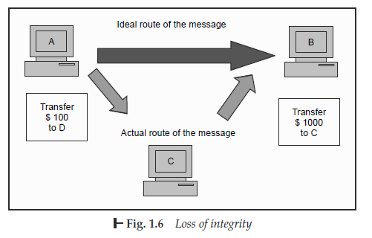

Slide 12
Security Goals (Cont.)
Non-repudiation
There are situations where a user sends a message and later on refuses that she had sent that message.
For instance, user A could send a funds transfer request to bank B over the Internet. After the bank performs the funds transfer as per A’s instructions, A could claim that she never sent the funds transfer instruction to the bank! Thus, A repudiates or denies, her funds transfer instruction.

Slide 13
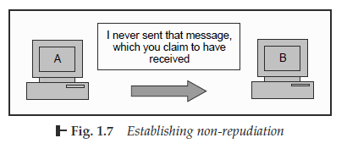

Slide 14
Security Goals (Cont.)
Access control
The principle of access control determines who should be able to access what. For instance, we should be able to specify that user A can view the records in a database, but cannot update them. However, user B might be allowed to make updates as well. An access control mechanism can be set up to ensure this. Access control is broadly related to two areas: role management and rule management. Role management concentrates on the user side (which user can do what), whereas rule management focuses on the resources side (which resource is accessible and under what circumstances). Based on the decisions taken here, an access control matrix is prepared, which lists the users against a list of items they can access (e.g. it can say that user A can write to file X, but can only update files Y and Z). An Access Control List (ACL) is a subset of an access control matrix.

Slide 15
Security Goals (Cont.)
Availability
The principle of availability is that resources should be available to authorized parties at all times.
For example, due to the intentional actions of an unauthorized user C, an authorized user A may not be able to contact a server B. This would defeat the principle of availability.
Such an attack is called interruption.

Slide 16
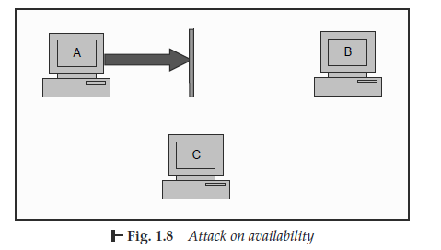

Slide 17
Aspects of Security
We consider 3 aspects of information security:
Security Attack
Security Mechanism
Security Service

Slide 18
Security Attacks
any action that compromises the security of information owned by an organization
information security is about how to prevent attacks, or failing that, to detect attacks on information-based systems
often threat & attack used to mean same thing
have a wide range of attacks
generic types of attacks: Passive attack and active attack.

Slide 19
Security Attacks (Cont.)
Passive Attack
A passive attack attempts to learn or make use of information from the system but does not affect system resources.
A passive attack, in computing security, is an attack characterized by the attacker listening in on communication. In such an attack, the intruder/hacker does not attempt to break into the system or otherwise change data
Goal: to obtain information that is being transmitted;
Passive attacks basically mean that the attacker is eavesdropping (listen secretly to or over-hear private conversation)

Slide 20
Security Attacks (Cont.)
Passive Attack
Two types of passive attacks are
The release of message contents and
Traffic analysis.

Slide 21
Security Attacks (Cont.)
Passive Attack
Release of message contents:
A telephone conversation, an electronic mail message, and a transferred file may contain sensitive or confidential information

Slide 22
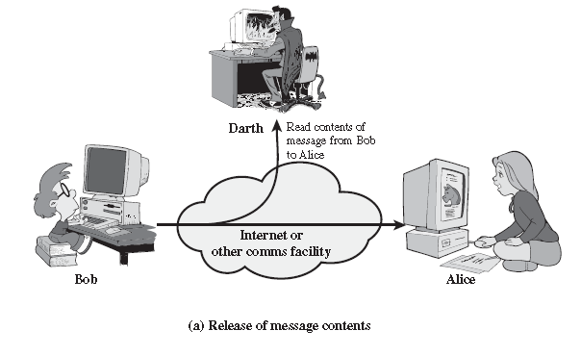

Slide 23
Security Attacks (Cont.)
Passive Attack
Traffic analysis:
By monitoring frequency and length of messages, even encrypted, nature of communication may be guessed
Traffic analysis is subtler (Figure b) Suppose that we had a way of masking the contents of messages or other information traffic so that opponents, even if they captured the message, could not extract the information from the message. The common technique for masking contents is encryption. If we had encryption protection in place, an opponent still might be able to observe the pattern of these messages. The opponent could determine the location and identity of communicating hosts and could observe the frequency and length of messages being exchanged. This information might be useful in guessing the nature of the communication that was taking place.

Slide 24
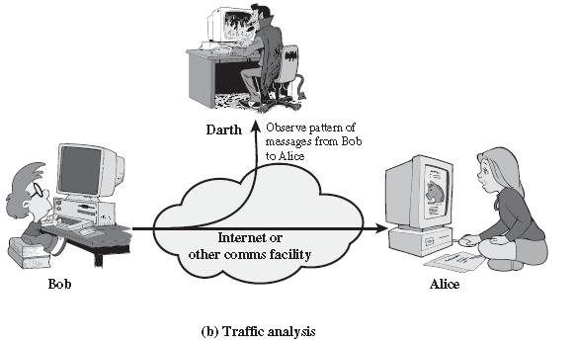

Slide 25
Security Attacks (Cont.)
Passive Attack
Passive attacks are very difficult to detect, because they do not involve any alteration of the data.
Typically, the message traffic is sent and received in an apparently normal fashion, and neither the sender nor the receiver is aware that a third party has read the messages or observed the traffic pattern.
However, it is feasible to prevent the success of these attacks, usually by means of encryption.

Slide 26
Security Attacks (Cont.)
Active Attack
An active attack attempts to alter system resources or affect their operation. Active attacks involve some modification of the data stream or the creation of a false stream.
Active attacks can be subdivided into four categories:
masquerade,
replay,
modification of messages, and
Denial of service.

Slide 27
Security Attacks (Cont.)
Active Attack
A masquerade takes place when one entity pretends to be a different entity. A masquerade attack usually includes one of the other forms of active attack.

Slide 28
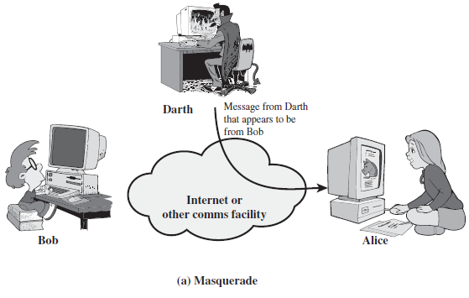

Slide 29
Security Attacks (Cont.)
Active Attack
Replay involves the passive capture of a data unit and its subsequent retransmission to produce an unauthorized effect.
For example, authentication sequences can be captured and replayed after a valid authentication sequence has taken place, thus enabling an authorized entity with few privileges to obtain extra privileges by impersonating an entity that has those privileges.

Slide 30
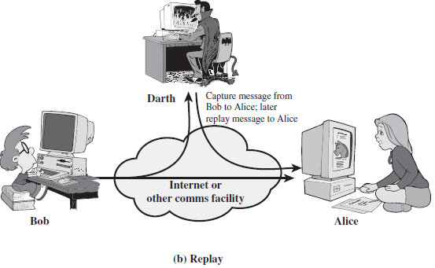

Slide 31
Security Attacks (Cont.)
Active Attack
Modification of messages simply means that some portion of a legitimate message is altered, or that messages are delayed or reordered, to produce an unauthorized effect.
For example, a message meaning “Allow John Smith to read confidential file accounts” is modified to mean “Allow Fred Brown to read confidential file accounts.”

Slide 32
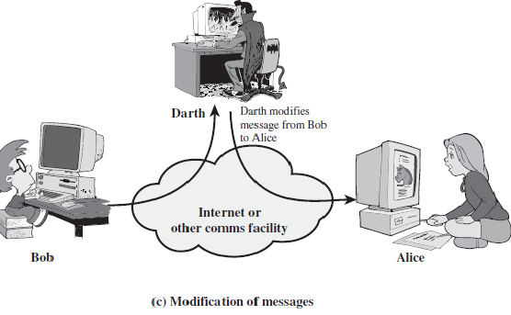

Slide 33
Security Attacks (Cont.)
Active Attack
The denial of service prevents or inhibits the normal use or management of communications facilities. This attack may have a specific target;
For example, an entity may suppress all messages directed to a particular destination (e.g., the security audit service).
Another form of service denial is the disruption of an entire network—either by disabling the network or by overloading it with messages so as to degrade performance.

Slide 34
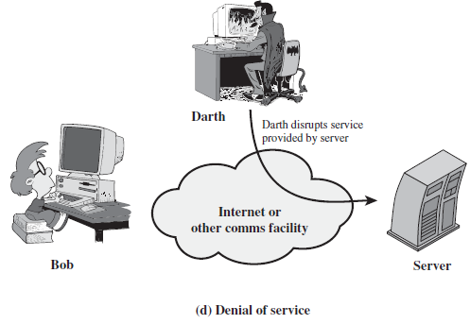

Slide 35
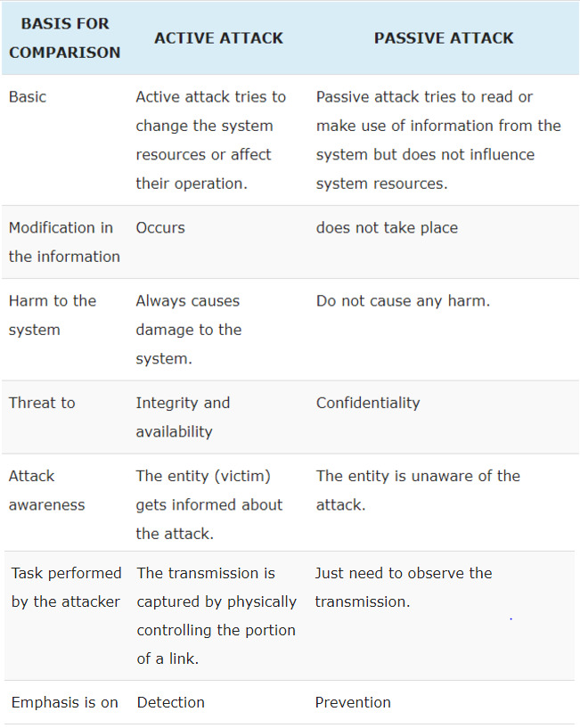

Slide 36
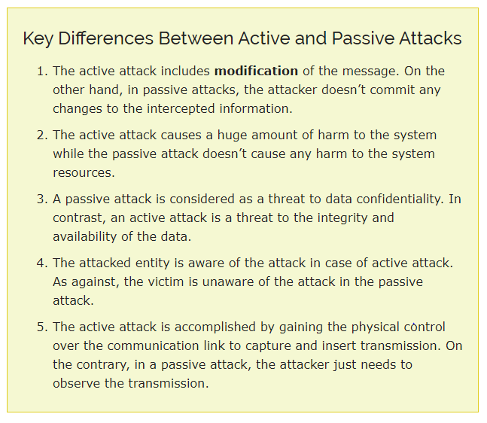

Slide 37
Security Services and Mechanism

Slide 38
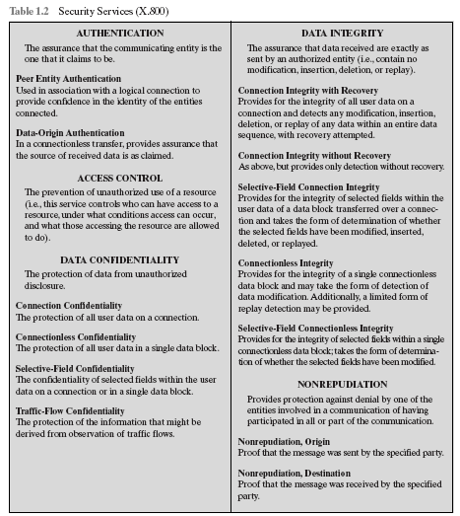

Slide 39
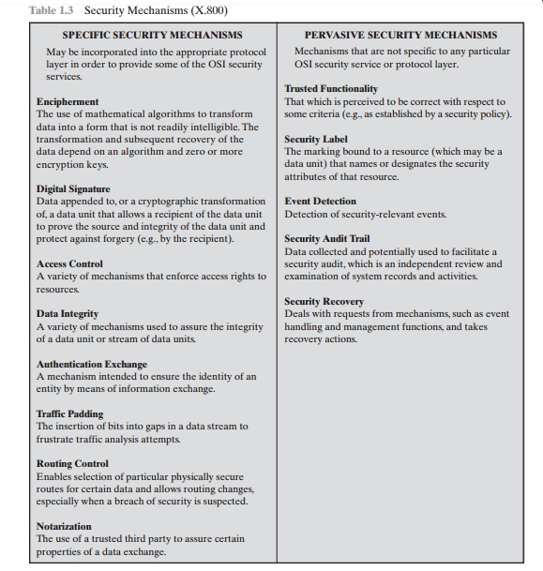

Slide 40
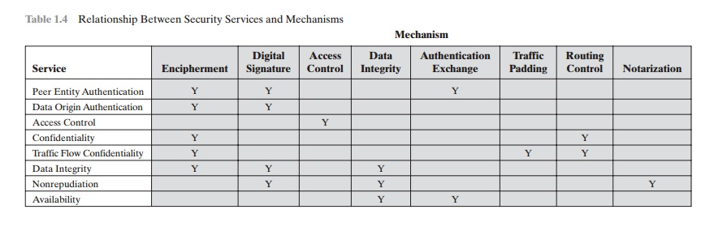

Slide 41
Cryptography Techniques
Some basic definitions
Cryptography is the art of achieving security by encoding messages to make them non readable.
Cryptography is a method of protecting information and communications through the use of codes so that only those for whom the information is intended can read and process it. The pre-fix "crypt" means "hidden" or "vault" and the suffix "graphy" stands for "writing."
Cryptanalysis is the technique of decoding messages from a non-readable format back to readable format without knowing how they were initially converted to readable format to non-readable format.
Cryptology is a combination of cryptography and cryptanalysis.
Plain text or clear text is ordinary readable text before being encrypted into ciphertext or after being decrypted.
When a plain text message is codified using any suitable scheme, the resulting message is called Cipher text.

Slide 42
Cryptography Techniques(cont.)
Three types of cryptographic techniques used in general
Symmetric – key Cryptography
Both the sender and receiver share a single key. The sender uses this key to encrypt plaintext and send the cipher text to the receiver. On the other side the receiver applies the same key to decrypt the message and recover the plain text.
Asymmetric – key Cryptography
In Public-Key Cryptography two related keys (public and private key) are used. Public key may be freely distributed, while its paired private key, remains a secret. The public key is used for encryption and for decryption private key is used.
Hash Functions
No key is used in this algorithm. A fixed-length hash value is computed as per the plain text that makes it impossible for the contents of the plain text to be recovered. Hash functions are also used by many operating systems to encrypt passwords.

Slide 43
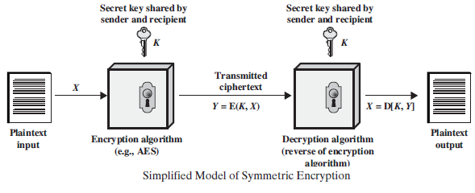
Classical Encryption
Symmetric Cipher Model

Slide 44
Symmetric Cipher Model
Basic terminology used
1. Plaintext: This is the original intelligible message or data that is fed into the algorithm as input.
2. Encryption algorithm: The encryption algorithm performs various substitutions and transformations on the plaintext.
3. Secret key: The secret key is also input to the encryption algorithm. The key is a value independent of the plaintext and of the algorithm. The algorithm will produce a different output depending on the specific key being used at the time. The exact substitutions and transformations performed by the algorithm depend on the key.
4. Cipher text: This is the scrambled message produced as output. It depends on the plaintext and the secret key. For a given message, two different keys will produce two different cipher texts. The cipher text is an apparently random stream of data and, as it stands, is unintelligible.
5. Decryption algorithm: This is essentially the encryption algorithm run in reverse. It takes the cipher text and the secret key and produces the original plaintext.

Slide 45
Techniques for Plain Text to Cipher Text Conversion
Transforming a plain text message into cipher text
Substitution techniques
Transposition techniques

Slide 46
Substitution Techniques
Caesar Cipher
Modified Caesar Cipher
Mono-alphabetic Substitution Cipher
Polygram Substitution Cipher
Poly-alphabetic Substitution Cipher
Playfair Cipher
Hill cipher
Vernam Cipher (One Time Pad)

Slide 47
Caesar Cipher
Invented by Julius Caesar (Gallic Wars), 46 BC
Replaces each alphabet with the one three places down (shift by 3)
Example: Replace each A with D, B with E, etc.

Slide 48
Caesar Cipher
A B C D E F G H I J K L M N O P Q R S T U V W X Y Z
D E F G H I J K L M N O P Q R S T U V W X Y Z A B C

Slide 49
Algorithm to Encrypt Caesar Cipher
1. Read each alphabet in the plain text, and plus the alphabet order by k=3
2. Repeat the process for all alphabets in the plain text message. And print out.
E.g., Plain text: Hope you are doing fine
Cipher text: Krsh brx duh grlqj ilqh

Slide 50
Plain Text and Cipher Text
Hi Amit,
Hope you are doing fine. How about meeting at the train station this Friday at 5 pm? Please let me know if it is ok with you.
Regards.
Atul
Kl Dplw,
Krsh brx duh grlqj ilqh. Krz derxw phhwlqj dw wkh wudlq vwdwlrq wklv Iulgdb dw 5 sp? Sohdvh ohw ph nqrz li lw lv rn zlwk brx.
Uhjdugv.
Dwxo
Plain text message
Corresponding cipher text message

Slide 51
Modified Version of Caesar Cipher
In stead of A replaced by D, they can be replaced by other number of shifting.
Once shift number K is decided, it would be constant and will be used for all other alphabets in that message.

Slide 52
Mono-alphabetic Substitution Cipher
The key space: all permutations of Σ = {A, B, C, …, Z}
Encryption given a key K:
each letter X in the plaintext P is replaced with K(X)
Decryption given a key K:
each letter Y in the ciphertext P is replaced with k⁻¹(Y)
Example:
A B C D E F G H I J K L M N O P Q R S T U V W X Y Z
K= B A D C Z H W Y G O Q X S V T R N M L K J I P F E U
BECAUSE → AZDBJSZ
Notes:
Cipher alphabet

Slide 53
Polygram Substitution Cipher
Block of plain text transformed into block of cipher text
Similar text patterns can yield completely different cipher text patterns
Block-by-block replacement (Word by word, not character by character)

Slide 54
Polygram Substitution Cipher
HELLO
Polygram Substitution
YUQQW
HELL
Polygram Substitution
TEUI

Slide 55
Poly_alphabetic substitution cipher
Vigenere Cipher is one of this type.
Vigenere Cipher assume a Table called Vigenere Table
Encryption: first define a key , read the plain text character one by one, mapping the read_in character and the corresponding key character by using the Vigenere Table,

Slide 56
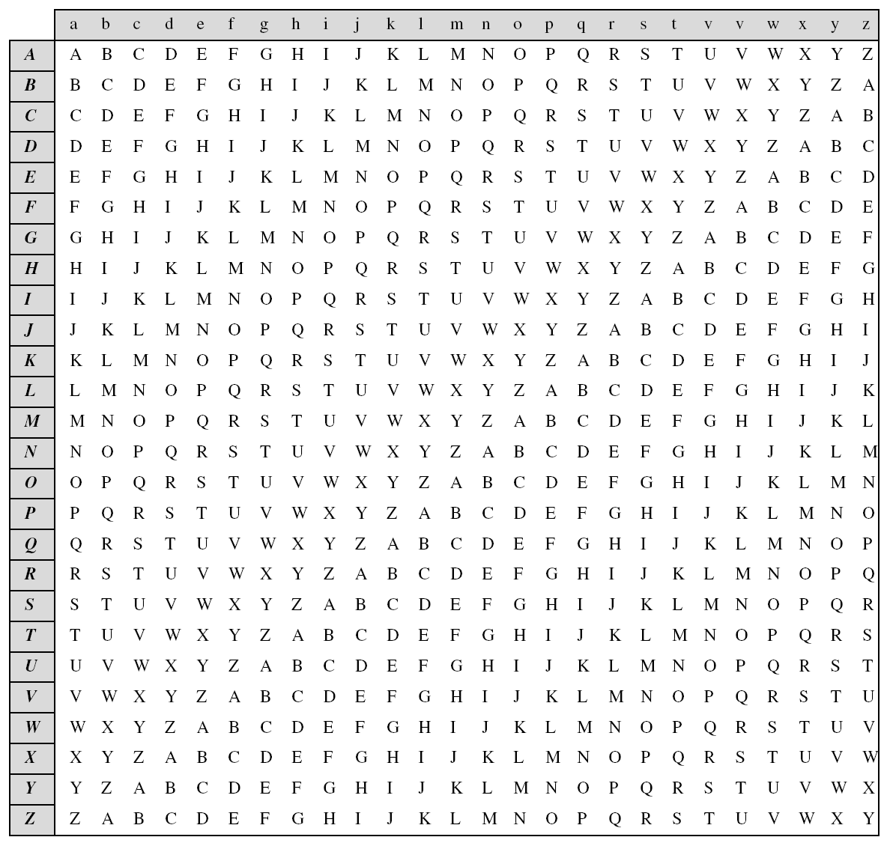

Slide 57
Vigenere Cipher(cont.)
Example:
Plaintext: C R Y P T O G R A P H Y
Key: L U C K L U C K L U C K
Ciphertext: N L A Z E I I B L J J I
Plaintext: UNIVERSITY
Key: HOUGHTON
Notes:
Ct: TONHOUGNTO

Slide 58
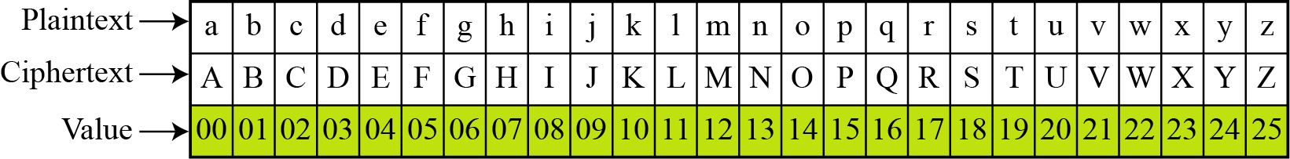
Vigenere Cipher(cont.)
Encryption:
e_{k}(p₁, p₂… p_{m}) = (p₁+k₁, p₂+k₂…p_{m}+k_{m}) (mod 26)
Decryption:
d_{k}(c₁, c₂… c_{m}) = (c₁-k₁, c₂-k₂ … c_{m}- k_{m}) (mod 26)
Notes:
Ct: TONHOUGNTO

Slide 59
Playfair Cipher
Best-known multiple-letter encryption cipher
Treats digrams in the plaintext as single units and translates these units into ciphertext digrams
Based on the use of a 5 x 5 matrix of letters constructed using a keyword
Invented by British scientist Sir Charles Wheatstone in 1854
Used as the standard field system by the British Army in World War I and the U.S. Army and other Allied forces during World War II

Slide 60
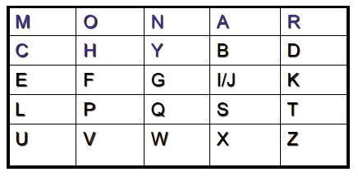
Playfair Key Matrix
Fill in letters of keyword (minus duplicates) from left to right and from top to bottom, then fill in the remainder of the matrix with the remaining letters in alphabetic order
Using the keyword MONARCHY:
Example:

Slide 61
Rules
Plaintext is encrypted two letters at a time, according to the following rules:
1. Repeating plaintext letters that are in the same pair are separated with a filler letter, such as x, so that balloon would be treated as ba lx lo on.
2. Two plaintext letters that fall in the same row of the matrix are each replaced by the letter to the right, with the first element of the row circularly following the last. For example, ar is encrypted as RM.
3. Two plaintext letters that fall in the same column are each replaced by the letter beneath, with the top element of the column circularly following the last. For example, mu is encrypted as CM.
4. Otherwise, each plaintext letter in a pair is replaced by the letter that lies in its own row and the column occupied by the other plaintext letter. Thus, hs becomes BP and ea becomes IM (or JM, as the encipherer wishes).

Slide 62
Example
key as: monarchy
Plain text as: balloon => ba lx lo on(since after ba ll(same letter repeating 2 times in between ll insert filler x = > lxl)
Plain Text Cipher Text
ba i b(since ba in same column)
lx su( for lx su is opposite diagonal)
lo pm(for lo pm is oposite diagonal)
on na (since na in same row )
Notes:
Pt: instrumentsz
Ct: gatlmzclrqtx

Slide 63
Hill Ciphers
Created by Lester S. Hill in 1929
Polygraphic Substitution Cipher
Uses Linear Algebra to Encrypt and Decrypt
Uses matrices to encrypt and decrypt
Uses modular arithmetic (Mod 26)

Slide 64
Modular Arithmetic
For a Mod b, divide a by b and take the remainder.
14 ÷ 10 = 1 R 4
14 Mod 10 = 4
24 Mod 10 = 4

Slide 65
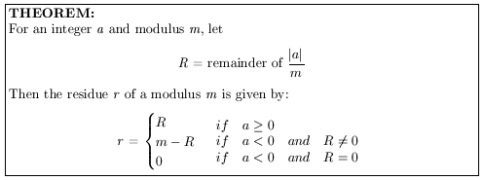
Modulus Theorem

Slide 66



Modulus Examples

Slide 67
Modular Inverses
Inverse of 2 is ½ (2 · ½ = 1)
Matrix Inverse: AA⁻¹= I
Modular Inverse for Mod m: (a · a⁻¹) Mod m = 1
For Modular Inverses, a and m must NOT have any prime factors in common

Slide 68
Modular Inverses of Mod 26
A | 1 | 3 | 5 | 7 | 9 | 11 | 15 | 17 | 19 | 21 | 23 | 25
A⁻¹ | 1 | 9 | 21 | 15 | 3 | 19 | 7 | 23 | 11 | 5 | 17 | 25
Example – Find the Modular Inverse of 9 for Mod 26
9 · 3 = 27
27 Mod 26 = 1
3 is the Modular Inverse of 9 Mod 26

Slide 69
Hill Cipher Matrices
One matrix to encrypt, one to decrypt
Must be n x n, invertible matrices
Decryption matrix must be modular inverse of encryption matrix in Mod 26

Slide 70
Modularly Inverse Matrices
Calculate determinant of first matrix A, det A
Make sure that det A has a modular inverse for Mod 26
Calculate the adjugate of A, adj A
Multiply adj A by modular inverse of det A
Calculate Mod 26 of the result to get B
Use A to encrypt, B to decrypt

Slide 71
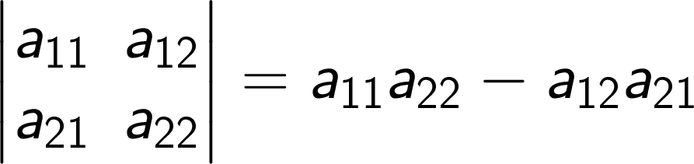
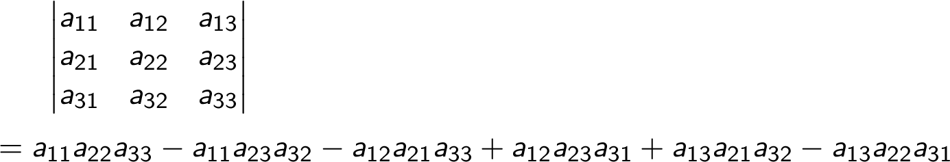
Matrix Determinant

Slide 72



Modular Reciprocal Example

Slide 73
Encryption
Assign each letter in alphabet a number between 0 and 25
Change message into 2 x 1 letter vectors
Change each vector into 2 x 1 numeric vectors
Multiply each numeric vector by encryption matrix
Convert product vectors to letters

Slide 74
Letter to Number Substitution
A | B | C | D | E | F | G | H | I | J | K | L | M
0 | 1 | 2 | 3 | 4 | 5 | 6 | 7 | 8 | 9 | 10 | 11 | 12
N | O | P | Q | R | S | T | U | V | W | X | Y | Z
13 | 14 | 15 | 16 | 17 | 18 | 19 | 20 | 21 | 22 | 23 | 24 | 25

Slide 75

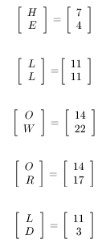
Change Message to Vectors
Message to encrypt = HELLO WORLD

Slide 76
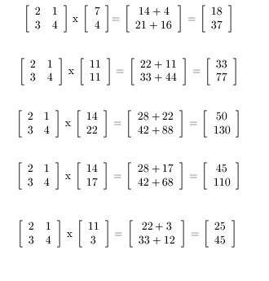
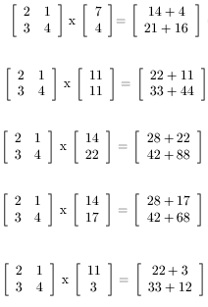
Multiply Matrix by Vectors

Slide 77
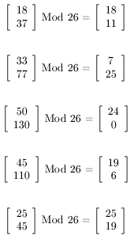
Convert to Mod 26

Slide 78
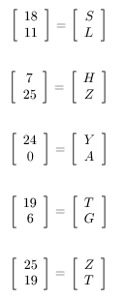
Convert Numbers to Letters
HELLO WORLD has been encrypted to
SLHZY ATGZT

Slide 79
Decryption
Change message into 2 x 1 letter vectors
Change each vector into 2 x 1 numeric vectors
Multiply each numeric vector by decryption matrix
Convert new vectors to letters

Slide 80

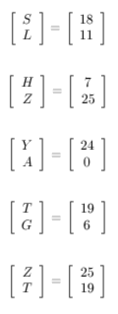
Change Message to Vectors
Message to encrypt = SLHZYATGZT

Slide 81
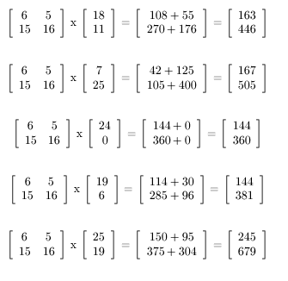
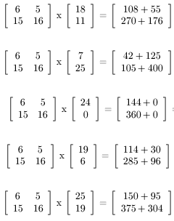
Multiply Matrix by Vectors

Slide 82
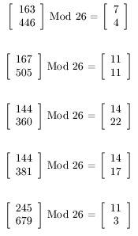
Convert to Mod 26

Slide 83
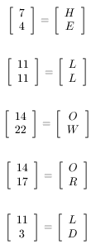
Convert Numbers to Letters
SLHZYATGZT has been decrypted to
HELLO WORLD

Slide 84
One time pad ( Vernam Cipher)
It is implemented using random set of non repeating characters as the input cipher text.
Once the key is used to encrypt and decrypt a single message it will never used again for any other message so it is called one time pad
The length of key must equal to length of original plain text.
Plain text: how are you
One time pad: NCBTZQARX

Slide 85
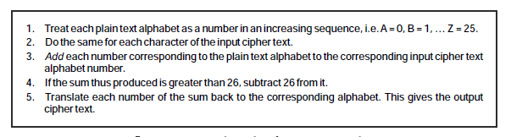

Slide 86
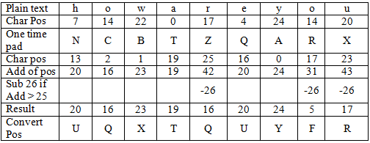
6.One time pad ( Vernam Cipher)

Slide 87
Transposition Techniques
Rail – Fence Technique
Simple Columnar Transposition Technique

Slide 88
1. Rail Fence Cipher
In this method plain text is written downwards on “rails of fence “ , starting a new column when bottom is reached.
Algorithm:
First write down plain text message as a sequence of diagonals.
Read the plain text written in first step as a sequence of rows.

Slide 89
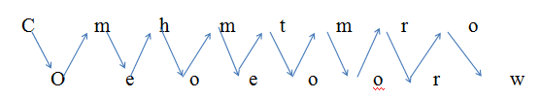
1. Rail Fence Cipher
Example:
Plain text: come home tomorrow
Cipher text: cmhmtmrooeoeoorw

Slide 90
1. Simple Columnar Transposition
In this method the message is written in rows of fixed length and then read out column by column
Column are selected in some in some scrambled order.
The number of columns are defined by the length of key.
Algorithm:
Write the plain text message row by row in a rectangle of predefined size.(length of key)
Read the message column by column according to the selected order thus obtained message is a cipher text.

Slide 91
1. Simple Columnar Transposition
Key: ZEBRAS
plain text: welcome home
Order : 6 3 2 4 1 5
Cipher text: MLOEHCMWEOE

Slide 92
2.Double Columnar Transposition
Single columnar transposition can be attack by guessing possible column lengths.
Therefore to make it stronger double transposition is used.
This is simple columnar transposition technique applied twice.
Here same key can be used for transposition or two different keys can be used.

Slide 93
2.Double Columnar Transposition
First apply simple columnar transposition
Key: ZEBRAS
plain text: welcome home
Order : 6 3 2 4 1 5
Cipher text: MLOEHCMWEOE

Slide 94

2.Double Columnar Transposition
Cipher text 1: MLOEHCMWEOE
Order : 6 3 2 4 1 5
Final Cipher Text: COELWEOMMHE

Slide 95
Substitution Cipher | Transposition Cipher
A substitution technique is one in which the letters/number/symbols of plain text are replaced by other letters/numbers/symbols. | In the transposition technique the positions of letters/numbers/symbols in plain text is changed with one another.
It is easy to understand. | It is difficult to understand.
Methods: Caesar's Cipher Modified Caesar’s Cipher Mono-Alphabetic Cipher A Polygram Substitution Cipher A Polyalphabetic Substitution Cipher e.g.Vigenere Cipher One time Pad(Vernam Cipher) Playfair Cipher Hill Cipher | Methods: Rail Fence Cipher Columnar Transposition Simple Columnar Transposition Double Columnar Transposition

Slide 96
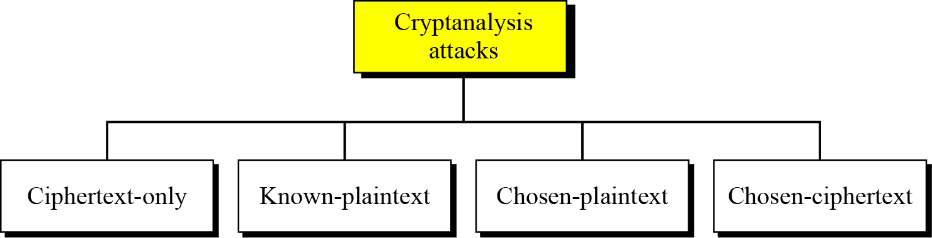
Cryptanalysis
As cryptography is the science and art of creating secret codes, cryptanalysis is the science and art of breaking those codes.
Cryptanalysis attacks

Slide 97
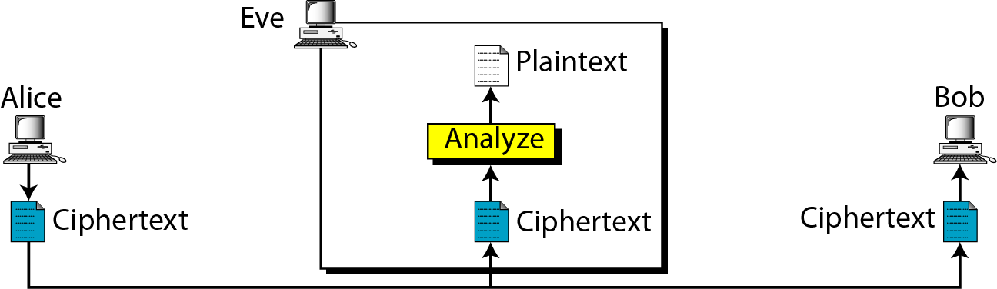
Continued
Ciphertext-Only Attack
Ciphertext-only attack

Slide 98
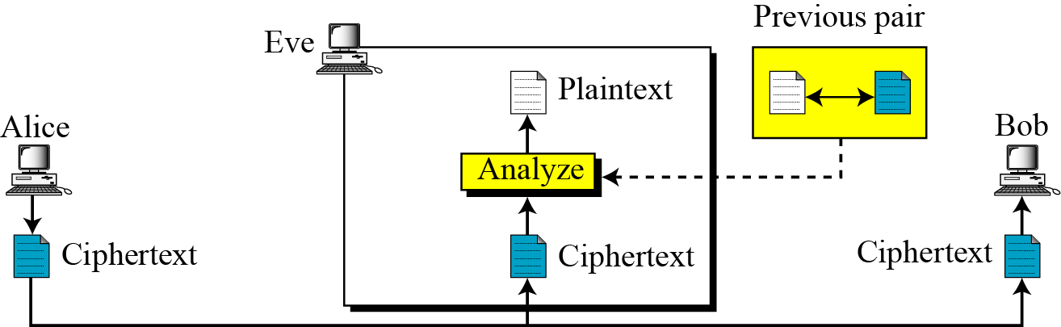
Continued
Known-Plaintext Attack
Known-plaintext attack

Slide 99
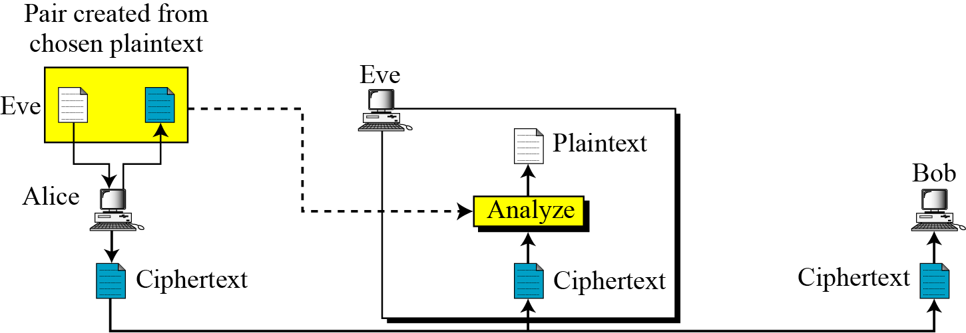
Continued
Chosen-Plaintext Attack
Chosen-plaintext attack

Slide 100
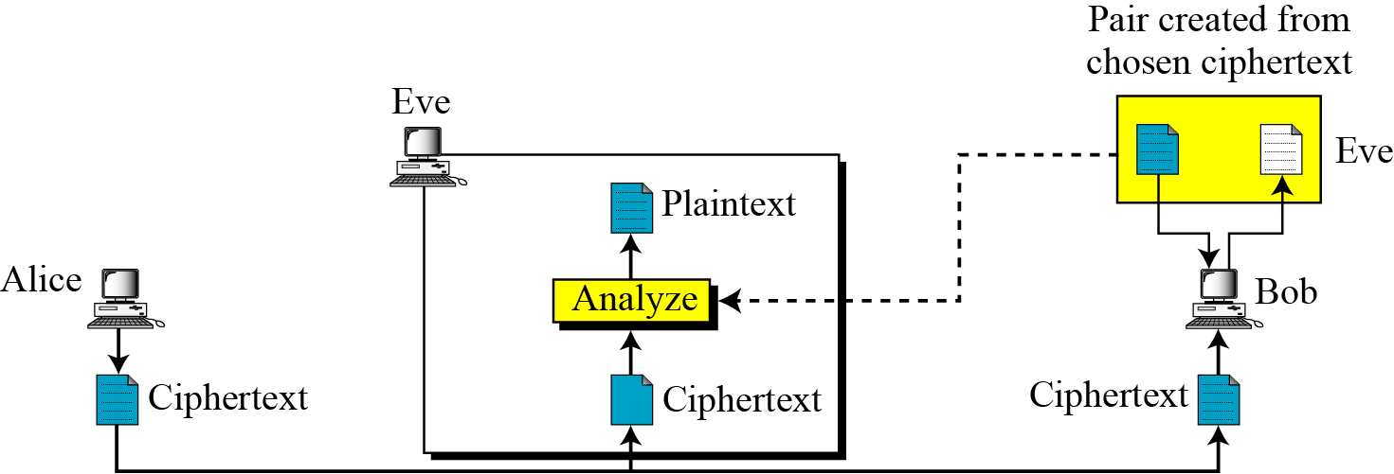
Continued
Chosen-Ciphertext Attack
Chosen-ciphertext attack

Slide 101
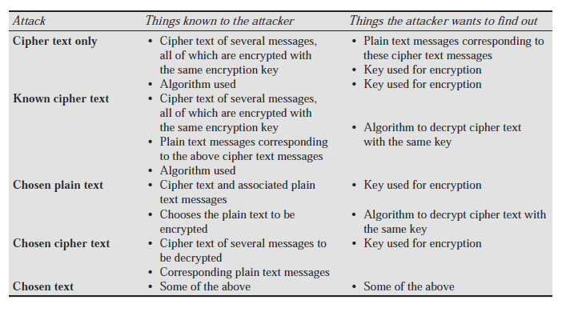

Slide 102
Steganography
Steganography is a technique that facilitates hiding of a message that is to be kept secret inside other messages. This results in the concealment of the secret message itself! Historically, the sender used methods such as invisible ink, tiny pin punctures on specific characters, minute variations between handwritten characters, pencil marks on handwritten characters, etc.
Of late, people hide secret messages within graphic images. For instance, suppose that we have a secret message to send. We can take another image file and we can replace the last two rightmost bits of each byte of that image with (the next) two bits of our secret message. The resulting image would not look too different and yet carry a secret message inside! The receiver would perform the opposite trick: it would read the last two bits of each byte of the image file and reconstruct the secret message.

Slide 103
